Slide 1

Object Oriented Programming
Behavioral Design Patterns: Strategy
IT620
Sourish Dasgupta
Assistant Professor, DA-IICT, Gandhinagar
https://daiict.ac.in/faculty/sourish-dasgupta

Slide 2
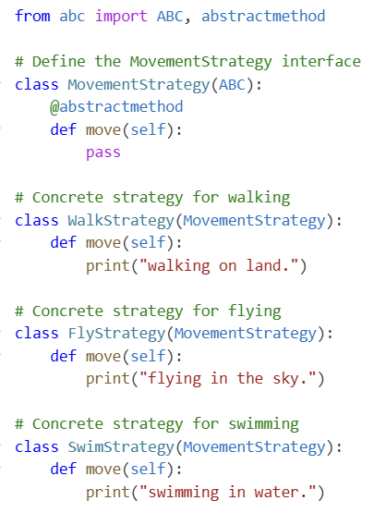
What if objects want to share each others’ behaviors runtime?
Movements (walk, fly, swim) is no single animal’s unique behavior
IT620: Behavioral Design Patterns: Strategy
Sourish Dasgupta

Slide 3
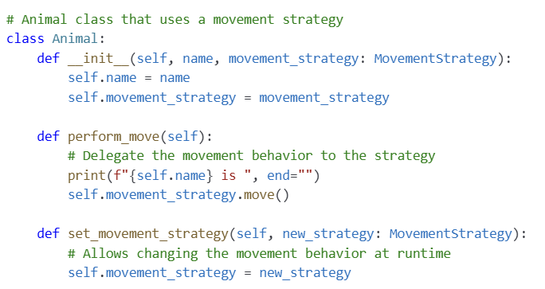
What if objects want to share each others’ behaviors runtime?
Keeping it generic
IT620: Behavioral Design Patterns: Strategy
Sourish Dasgupta

Slide 4
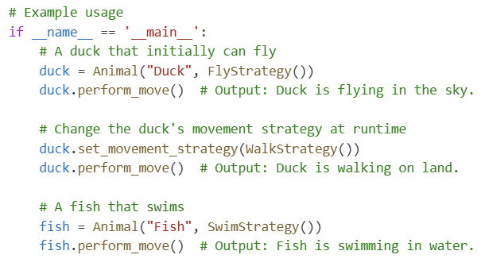
What if objects want to share each others’ behaviors runtime?
IT620: Behavioral Design Patterns: Strategy
Sourish Dasgupta

Slide 5
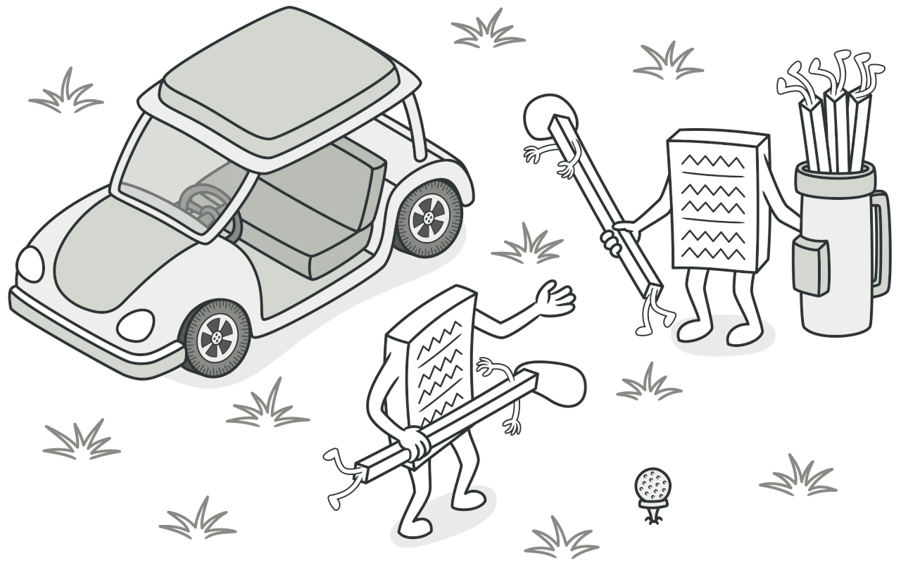
Separating Object from Behaviors
IT620: Behavioral Design Patterns: Strategy
Sourish Dasgupta

Slide 6
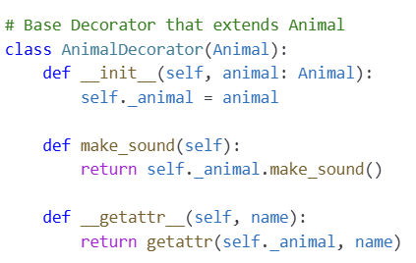
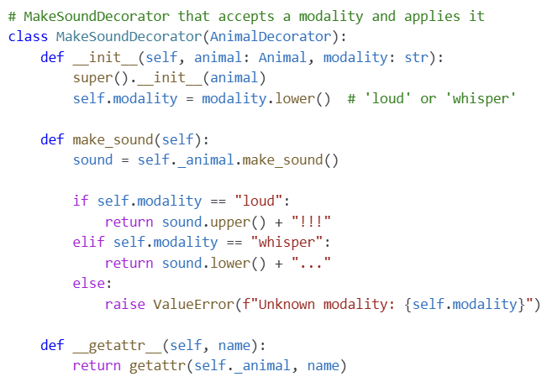
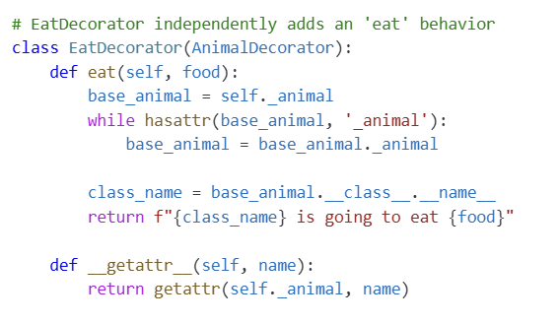
Wait! We added behavior earlier as well? Decorator!
(Remember the dogs barking and eating??)
IT620: Structural Design Patterns: Decorator
Sourish Dasgupta

Slide 7
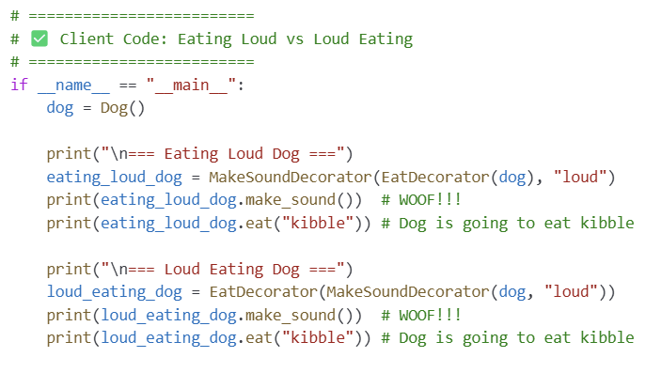
Wait! We added behavior earlier as well? Decorator!
(Remember the dogs barking and eating??)
IT620: Structural Design Patterns: Decorator
Sourish Dasgupta

Slide 8
Then why not the Decorator way?
Aspect | Decorator Pattern | Strategy Pattern
Purpose | Add or augment functionalities to objects dynamically without modifying their structure | Family of algorithms → encapsulate each → make them interchangeable Algorithm can vary independently from clients
Use Case | When you need to attach additional responsibilities to an object dynamically and transparently. | When you have multiple algorithms for a specific task and want to switch between them at runtime.
Structure | Utilizes composition to wrap objects with new behavior | Utilizes composition to delegate specific behaviors to different strategy classes
IT620: Behavioral Design Patterns: Strategy
Sourish Dasgupta

Slide 9
Then why not the Decorator way?
Aspect | Decorator Pattern | Strategy Pattern
Flexibility | Allows combining multiple behaviors by stacking decorators | Allows changing the behavior of a class by switching strategies (typically one strategy at a time)
Example Scenario | Adding scrolling, borders, or drop shadows to GUI | Implementing different sorting algorithms that can be selected based on the dataset.
Relation to Object | Enhances the object by wrapping it, effectively changing its "skin". | Alters the object's behavior by changing its "brain", i.e., the underlying algorithm.
IT620: Behavioral Design Patterns: Strategy
Sourish Dasgupta

Slide 10
Key takeaways
Advantages | Explanation
Variable Behavior | Object's behavior is likely to change or vary in different contexts (e.g., a duck that can both fly and walk) → encapsulating behaviors separately allows easy swapping or modification
Multiple Implementations | Several ways to perform a specific action (e.g., different movement types: flying, walking, swimming) → reuse and clear organization
IT620: Behavioral Design Patterns: Strategy
Sourish Dasgupta

Slide 11
Key takeaways
Advantages | Explanation
Separation of Concerns | Keeping the core class focused on its primary responsibilities while delegating secondary behaviors (like movement) to separate components makes the code easier to understand, maintain, and test.
Adherence to SOLID Principles | Specifically, the open/closed principle is supported—your core class (e.g., Animal) is closed for modification but open for extension through new behaviors without modifying its code.
Dynamic Behavior Change | If the behavior needs to change at runtime based on different conditions (like an animal adapting its movement in response to environmental changes), separating it allows for dynamic switching of algorithms.
IT620: Behavioral Design Patterns: Strategy
Sourish Dasgupta

